Slide 1
Project title: Text on 4x64 Dot Matrix Display through Arduino Nano Presented by:
1. Sadik Munha (ID: 1931437042)
2. Rakib-Ul-Islam (ID: 1931283642)
3. Md. Rakibul Hasan (ID: 1912435042)

Slide 2
Introduction
A dot-matrix display is a low cost electronic digital display device that displays information on machines such as clocks, watches, calculators, and many other devices requiring a simple alphanumeric (and/or graphic) display device of limited resolution.
On the other hand, The Arduino Nano is Arduino's classic breadboard friendly designed board with the smallest dimensions. The Arduino Nano comes with pin headers that allow for an easy attachment onto a breadboard and features a Mini-B USB connector.

Slide 3
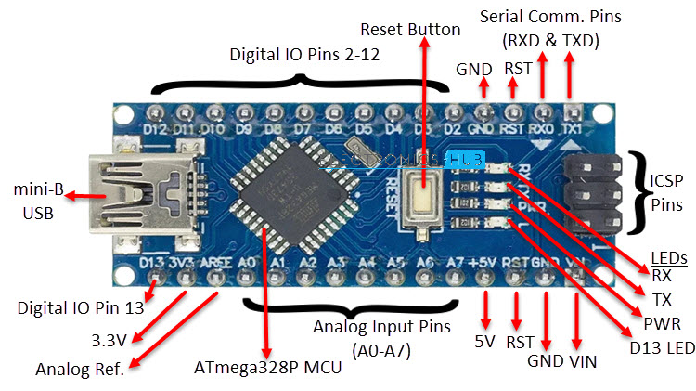
Required Components
Arduino Nano:
It is a small, complete, and breadboard-friendly board based on the ATmega328P
It has 22 input/output pins in total.
14 of these pins are digital pins.
Arduino Nano has 8 analogue pins.
It has 6 PWM pins among the digital pins.
It has a crystal oscillator of 16MHz.
It's operating voltage varies from 5V to 12V.
It's operating voltage varies from 5V to 12V.

Slide 4
Required Components
MAX 7219- 4 in 1 LED Dot Matrix Display:
A 4 in 1 dot led matrix display module is a display board arranged in series from four 8 x 8 Dot Matrix which can print characters using LEDs or the group of LEDs.
Easy to interface with microcontrollers.
This display made of 32 columns and 8 rows of LEDs
So it has total of 32×8 = 256 numbers of LEDs
Each 8×8 LED matrix has a MAX7219 common-cathode display driver IC with
serial input and parallel output.
So the display module has four MAX7219 display driver IC.

Slide 5
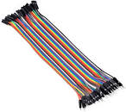
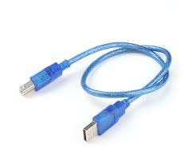
Required Components
5 line Jumper Wire:
USB cable:

Slide 6
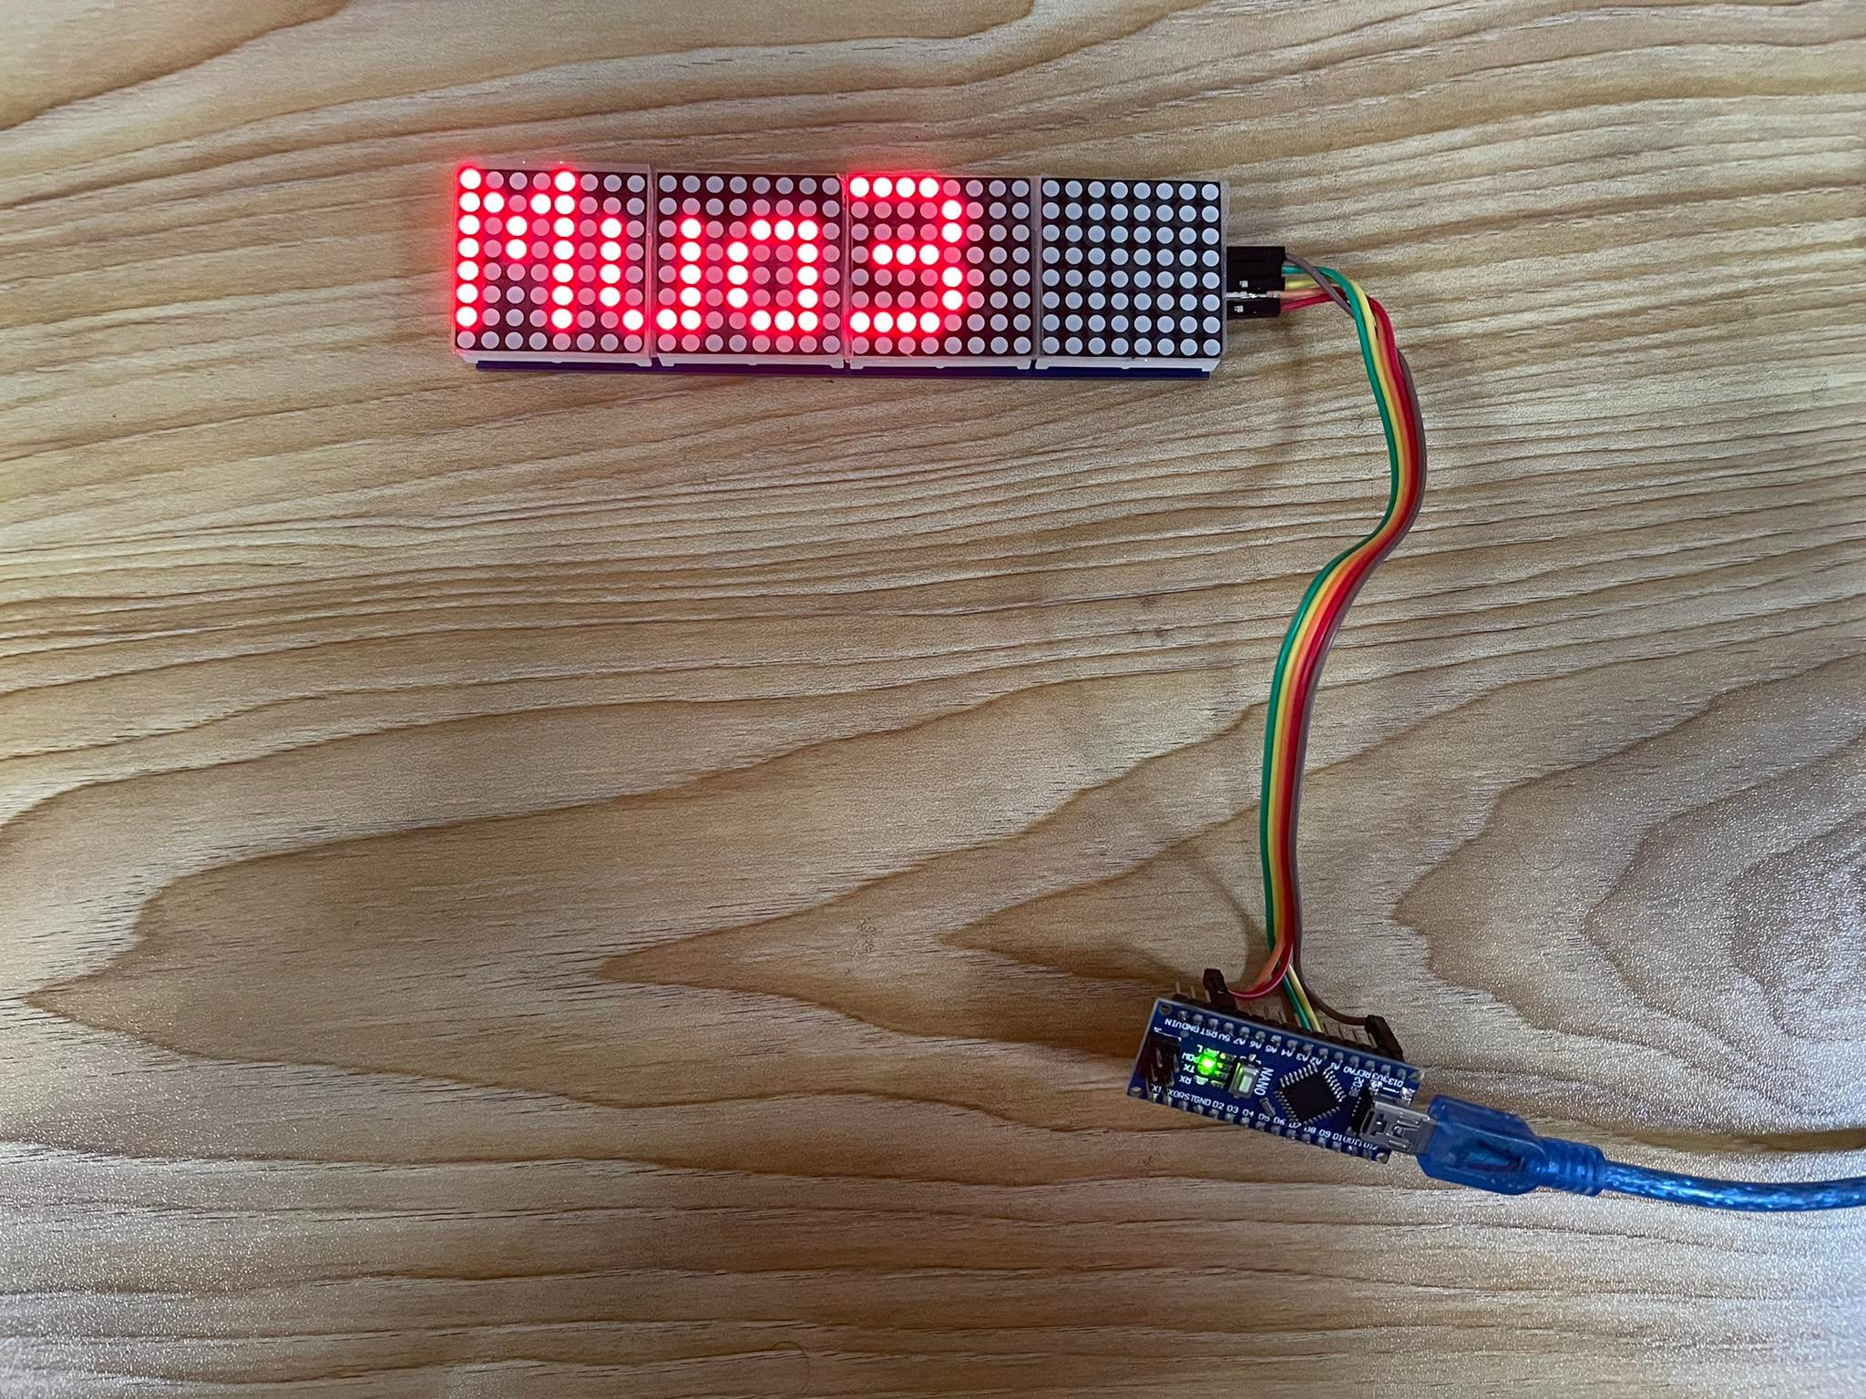
Functions
Scrolling
Display Message
Scrolling speed
Speed Deadband
Scroll Effect
Scroll Allign
Scroll pause
Buffers Size

Slide 7
Working Procedure
First, gathering the parts was our top priority. We collected the knowledge of every component we used to set up for our project from Google.
Then we ordered the necessary components (dot matrix display, Arduino Uno, jumper wire, etc.) from an online platform.
Then we began writing code. As a result, we advanced to the connection part.
In our display section, there are 64-piece LEDs in every module.
We used 5 line jumper wire as a connector.
After that, we connected the jumper wire with the dot matrix display.
Again on the other side of connecting cable, we connected it with the Arduino Nano.

Slide 8
Connection between Jumper wire and Dot matrix Display
Red cable VCC
Orange cable Ground Pin (GND)
Yellow cable Data Input pin
Green cable Chip Selection Pin (CS)
Brown cable Clock Pin (CLK)

Slide 9
Connection between Connecting wire and Arduino Nano
Red cable 5 Volt
Orange cable Ground Pin
Brown/Clock Pin 13 no pin
Data pin 11 no pin
CS pin 10 no pin.

Slide 10
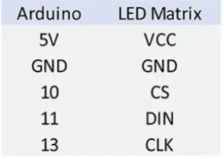
Connection
VCC | Connect to + 5v power supply
GND | Connect to the ground of power supply
DIN | Connect to the microcontroller I/O pin to providing data to display.
CS | It allows chip activation.
CLK | Serial-Clock Input pin that Connect to the microcontroller I/O pin to providing clock input to display.

Slide 11
Working Procedure
Then we will connect the Arduino module with the PC using a USB cable.
After that, we used Arduino Nano (IDE 1.8.19) to compile the code.
The Arduino Nano was then programmed using the code.
Finally, we noticed that the input we entered into the code began to appear on the dot matrix display.
`This is how we got the outcome we wanted.

Slide 12




Arduino Code

Slide 13
Conclusion
With the help of the Arduino Nano we can make more interesting projects like:
Nano Automated plant Watering system
Color-Changing Coffee Table
Motion Activated Light
Sensor Controlled Guard Lights Arduino Nano Security System

Slide 14


